Slide 1
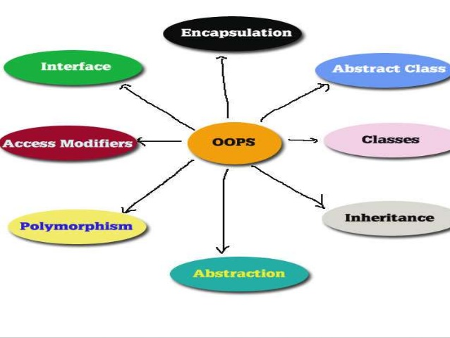
Object Oriented Programming & Design
Session – 10: 13-Jan-2019
Notes:
NOTE:
To change the image on this slide, select the picture and delete it. Then click the Pictures icon in the placeholder to insert your own image.

Slide 2

Agenda
Java Type System
The Class class
Java Object Model
Java Generics

Slide 3
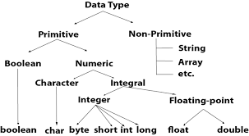
Type System Java

Slide 4
Java Types
A statically typed language is one in which variables have definite types, and where it is a compile-time error to assign a value of an incompatible type to a variable.
Java is an example of a statically typed language. Languages that only check type compatibility at runtime are called dynamically typed—JavaScript is an example of a dynamically typed language.
In Java a type is a set of values with a set of Operations that can be applied to the values.
Example :
  int type -Set of values { [-2^31] to [+2^31-1])}
  Operations : All Arithmetic Operations
  BOX type - Set of all BOX object references
  Operations : area() , volume() , toString()
Java is Strongly Typed Language. Type checking is done both at Compile and Run Time. If a Type Check Fails at Compile Time - Compile Time Error If a Type Check Fails at Run Time - RunTime Exception

Slide 5
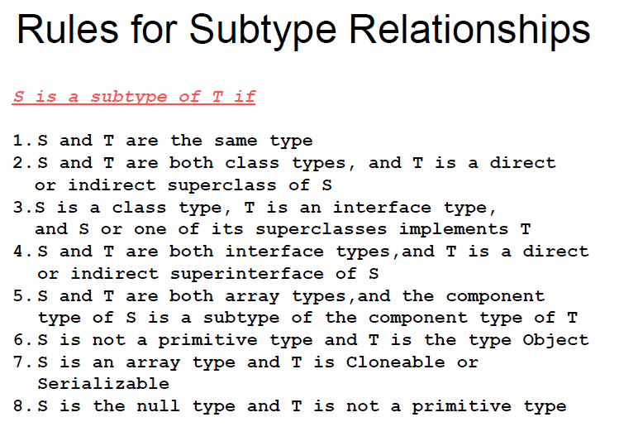
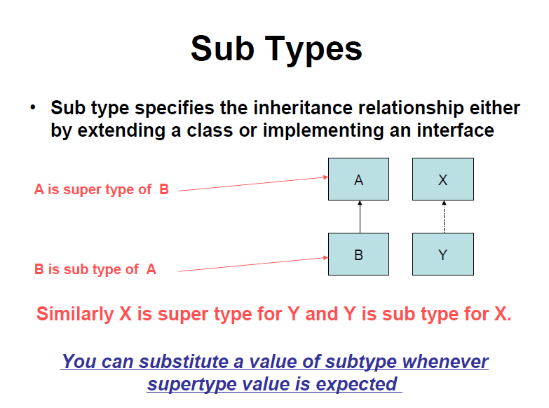
Java Types – Sub Types

Slide 6
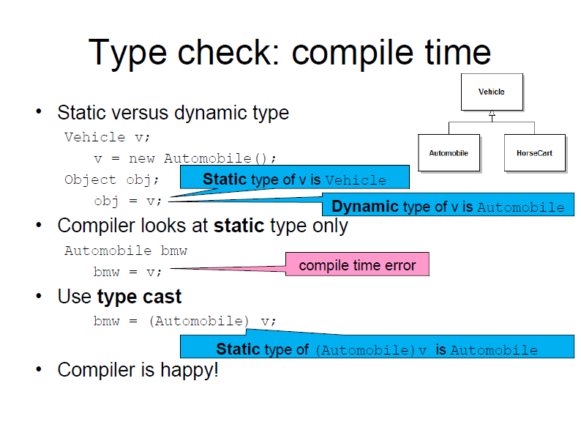
Type Checking

Slide 7
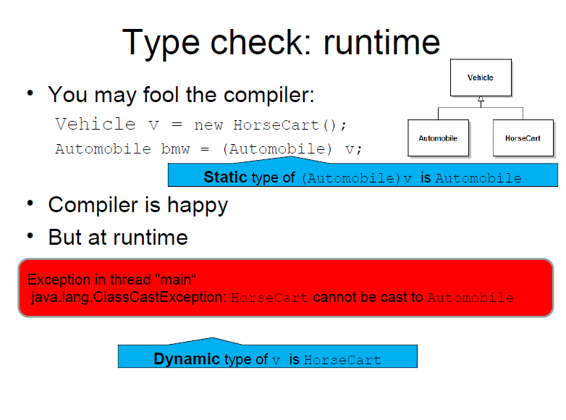
Type Checking

Slide 8
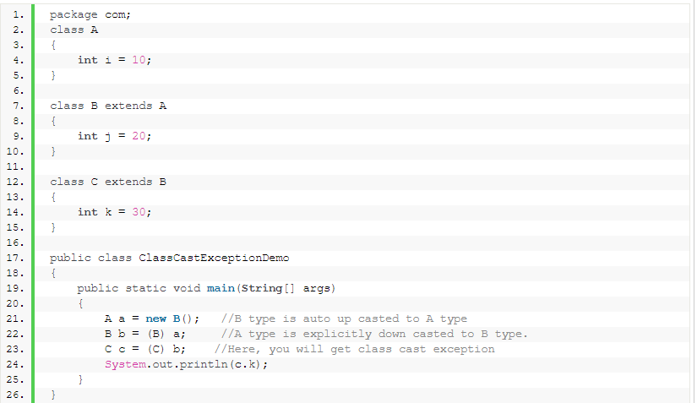
Type Checking - Class Cast Exception
ClassCastException in java is a run time error it occurs when an object can not be casted to another type.
An object is automatically upcasted to its super class type. You need not to mention class type explicitly.
But, when an object is supposed to be downcasted to its sub class type, then you have to mention class type explicitly.
In such case, there is a possibility of occurring class cast exception. In most of time, it occurs when you are trying to downcast an object explicitly to its sub class type.

Slide 9
Type Checking - Class Cast Exception
In the above example, Class B extends Class A and Class C extends Class B.
In the main method, Class B-type object is created (Line 21).
It will be having two non-static fields. one field (int i) is inherited from class A and another one is its own field (int j). ‘a’ is Class A-type reference variable which will be pointing to this newly created object.
In the next statement (Line 22), reference variable ‘a’ is assigned to ‘b’ which is Class B-type reference variable.
After execution of this statement, ‘b’ will also be pointing to the same object to which ‘a’ is pointing. In the third statement, ‘b’ is assigned to ‘c’ which is Class C-type reference variable.
So, ‘c’ will also be pointing to same object to which ‘a’ and ‘b’ are pointing. While executing this statement, you will get run time exception called Class Cast Exception.

Slide 10
Type Checking
Every sub class extends its super class. i.e every child class will have some additional properties along with some inherited properties from its parent class.
In the above example, Class A has one property (int i).
Class B has two properties, one is it’s own and another one is inherited.
Class C has three properties. one is it’s own and two are inherited.
In this example, Class C-type reference variable is referring to Class B-type object.
Class B-type object will be having only two properties. But, through Class C-type reference variable, you can access Class C’s own property (int k) like in the line 24.
But, actually this property does not exist in Class B-type object. This creates the confusion. Class B-type can not be casted to Class C-type. That’s why, you will get class cast exception.
Put ClassCastException in simple terms. ClassCastException occurs when code has attempted to cast an object to a type of which it is not an object. In the above example, Class B is a Class A type but Class B is not a Class C type. Therefore, you are getting ClassCastException.

Slide 11
Wrappers
Primitive types aren't Objects in Java.
We Can wrap primitive types in Objects using wrapper classes.
Wrapper class for each type are:
Integer Short Long Byte Character Float Double Boolean
Auto-boxing and auto-unboxing
  ArrayList<Integer> numbers = new ArrayList<Integer>();
  numbers.add(13); // calls new Integer(13)
  int n = numbers.get(0); // calls intValue();
Wrapper classes are immutable.

Slide 12
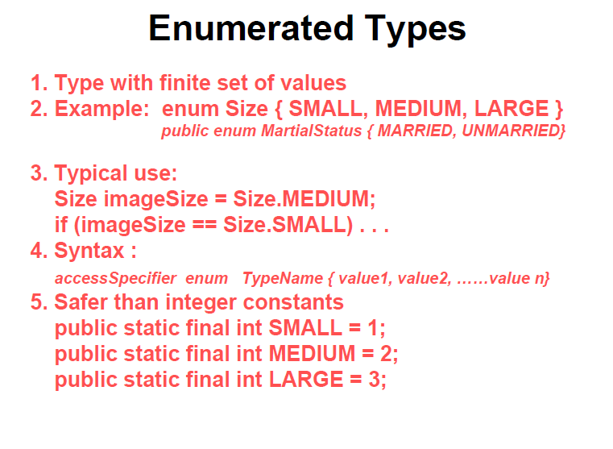
Enumerated Type

Slide 13
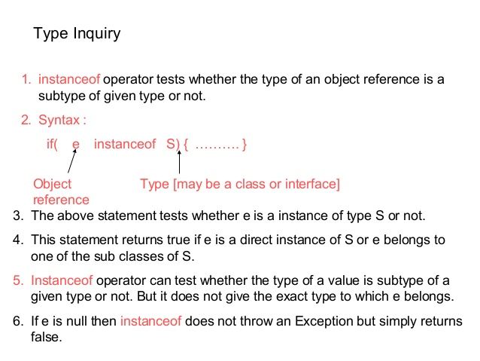
Type Inquiry

Slide 14

Class CLASS
No You are Not seeing Double

Slide 15
Class class
Java provides a class with name Class in java.lang package.
Instances of the class Class represent classes and interfaces in a running Java application.
The primitive Java types (boolean, byte, char, short, int, long, float, and double), and the keyword void are also represented as Class objects. It has no public constructor.
Class objects are constructed automatically by the Java Virtual Machine(JVM). It is a final class, so we cannot extend it.
Given a object reference we can know the exact type of the object by using getClass() method
  Class c = e.getClass();
getClass() method returns a Class Object. Once you have a class object its name can be printed as follows
  System.out.println(e.getClass().getName());
Adding the suffix .class to a type also yields the Class object.
Rectangle.class, Employee.class , Student.class

Slide 16
Exact Reference of a Class
Adding a suffix .class to a class name always yields a Class Object.
To test whether std is a reference belonging to class Student or not use
  if (std.getClass() == Student.class)
To test whether emp is a reference for Employee class object or not
  if(emp.getClass() == Employee.class)
What about Arrays ?
  BOX[ ] box = new BOX[5];
  Class c = box.getClass();
  if( c.isArray())
    S.O.P (“ Component Type :”+ c.getComponentType());

Slide 17
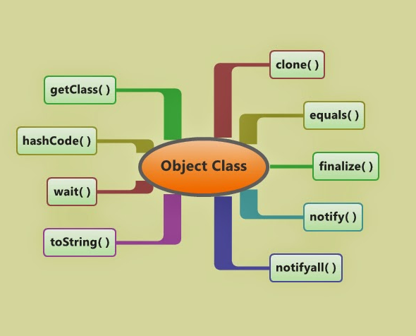
OBJECT CLASS

Slide 18
Object Class
The Object class is the parent class of all the classes in java by default. In other words, it is the topmost class of java.
The Object class is beneficial if you want to refer any object whose type you don't know.
Notice that parent class reference variable can refer the child class object, know as casting.
Let's take an example, there is getObject() method that returns an object but it can be of any type like Employee,Student etc, we can use Object class reference to refer that object.
For example:
Object obj=getObject();//we don't know what object will be returned from this method
The Object class provides some common behaviors to all the objects such as object can be compared, object can be cloned, object can be notified etc.

Slide 19
Methods of Object Class
toString() : toString() provides String representation of an Object and used to convert an object to String. The default toString() method for class Object returns a string consisting of the name of the class of which the object is an instance, the at-sign character `@’, and the unsigned hexadecimal representation of the hash code of the object.
hashCode() : For every object, JVM generates a unique number which is hashcode. It returns distinct integers for distinct objects. A common misconception about this method is that hashCode() method returns the address of object, which is not correct. It convert the internal address of object to an integer by using an algorithm.
equals(Object obj) : Compares the given object to “this” object (the object on which the method is called). It gives a generic way to compare objects for equality. It is recommended to override equals(Object obj) method to get our own equality condition on Objects. getClass() : Returns the class object of “this” object and used to get actual runtime class of the object. It can also be used to get metadata of this class. The returned Class object is the object that is locked by static synchronized methods of the represented class. As it is final so we don’t override it.
clone() : It returns a new object that is exactly the same as this object. For clone() method refer Clone()
Notes:
Use of hashCode() method : Returns a hash value that is used to search object in a collection. JVM(Java Virtual Machine) uses hashcode method while saving objects into hashing related data structures like HashSet, HashMap, Hashtable etc. The main advantage of saving objects based on hash code is that searching becomes easy.
Note : Override of hashCode() method needs to be done such that for every object we generate a unique number. For example,for a Student class we can return roll no. of student from hashCode() method as it is unique.

Slide 20
Cloning
While not recommended, cloning is a viable way to copy an object. Let's dive into Shallow Cloning, Deep Cloning, how to use them both, and when to avoid them.
Cloning is also a way of creating an object, but in general, cloning is not just about creating a new object. Cloning means creating a new object from an already present object and copying all data of the given object to that new object.
In order to create a clone of an object, we generally design our class in such a way that:
  Our class should implement the Cloneable interface. Otherwise, the JVM will throw CloneNotSupportedException if we will call clone() on our object.
  Our class should have a clone method, which should handle CloneNotSupportedException.
And finally, we need to call the clone() method of the superclass, which will call its super’s clone(). This chain will continue until it reaches the clone() method of the Object class. The Object.clone() method is the actual worker that creates the clone of your object, and another clone() method just delegates the call to its parent’s clone().

Slide 21
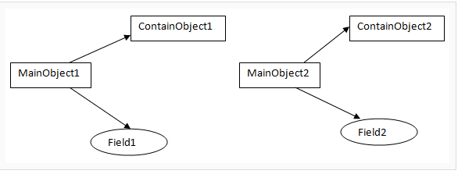
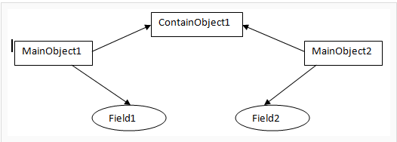
Shallow vs Deep Copy
Shallow copy A new object is created that has an exact copy of the values in the original object. If any of the fields of the object are references to other objects, just the reference addresses are copied i.e., only the memory address is copied.
A deep copy copies all fields, and makes copies of dynamically allocated memory pointed to by the fields. A deep copy occurs when an object is copied along with the objects to which it refers.
In this figure, the MainObject1 have fields "field1" of int type, and "ContainObject1" of ContainObject type.
When you do a deep copy of MainObject1, MainObject2 is created with "field2" containing the copied value of "field1" and "ContainObject2" containing the copied value of ContainObject1.
So any changes made to ContainObject1 in MainObject1 will not reflect in MainObject2.
In this figure, the MainObject1 have fields "field1" of int type, and "ContainObject1" of ContainObject type.
When you do a shallow copy of MainObject1, MainObject2 is created with "field2" containing the copied value of "field1" and "ContainObject2" containing reference of ContainObject1.
So any changes made to ContainObject1 in MainObject1 will reflect in MainObject2.

Slide 22
Cloning Disadvantages
Disadvantage of Object cloning
Following is a list of some disadvantages of clone() method:
To use the Object.clone() method, we have to change a lot of syntaxes to our code, like implementing a Cloneable interface, defining the clone() method and handling CloneNotSupportedException, and finally, calling Object.clone() etc.
We have to implement cloneable interface while it doesn?t have any methods in it. We just have to use it to tell the JVM that we can perform clone() on our object.
Object.clone() is protected, so we have to provide our own clone() and indirectly call Object.clone() from it.
Object.clone() doesn?t invoke any constructor so we don?t have any control over object construction.
If you want to write a clone method in a child class then all of its superclasses should define the clone() method in them or inherit it from another parent class. Otherwise, the super.clone() chain will fail.
Object.clone() supports only shallow copying but we will need to override it if we need deep cloning.

Slide 23
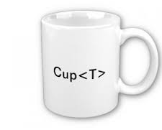
GENERICS

Slide 24
Generics
Prior to 1.5, Collections enabled programmers to store any type of objects.
As a result, code had to depend on type casting, failing which, errors were aplenty.
In a nutshell, generics enable types (classes and interfaces) to be parameters when defining classes, interfaces and methods.
Much like the more familiar formal parameters used in method declarations, type parameters provide a way for you to re-use the same code with different inputs.
The difference is that the inputs to formal parameters are values, while the inputs to type parameters are types.

Slide 25
Generics - Benefits
Stronger type checks at compile time: A Java compiler applies strong type checking to generic code and issues errors if the code violates type safety. Fixing compile-time errors is easier than fixing runtime errors, which can be difficult to find.
Elimination of casts: The following code snippet without generics requires casting:
List list = new ArrayList();
list.add("hello");
String s = (String) list.get(0);
When re-written to use generics, the code does not require casting:
List<String> list = new ArrayList<String>();
list.add("hello");
String s = list.get(0); // no cast
Enabling programmers to implement generic algorithms:By using generics, programmers can implement generic algorithms that work on collections of different types, can be customized, and are type safe and easier to read.

Slide 26
Generics - Types
A generic type is a generic class or interface that is parameterized over types. Begin by examining a non-generic Box class that operates on objects of any type.
It needs only to provide two methods: set, which adds an object to the box, and get, which retrieves it:
Since its methods accept or return an Object, you are free to pass in whatever you want, provided that it is not one of the primitive types. There is no way to verify, at compile time, how the class is used. One part of the code may place an Integer in the box and expect to get Integers out of it, while another part of the code may mistakenly pass in a String, resulting in a runtime error.
Simple Box Class
public class Box {
private Object object;
public void set(Object object) {
this.object = object;
}
public Object get() {
return object;
}
}

Slide 27
Generics – Generic Form of a Class
A generic class is defined with the following format:
class name<T1, T2, ..., Tn> { /* ... */ }
The type parameter section, delimited by angle brackets (<>), follows the class name. It specifies the type parameters (also called type variables) T1, T2, ..., and Tn.
To update the Box class to use generics, you create a generic type declaration by changing the code "public class Box" to "public class Box<T>".
This introduces the type variable, T, that can be used anywhere inside the class. As you can see, all occurrences of Object are replaced by T.
A type variable can be any non-primitive type you specify: any class type, any interface type, any array type, or even another type variable.
This same technique can be applied to create generic interfaces.
/** * Generic version of the Box class.
@param <T> the type of the value being boxed
*/
public class Box<T> {
// T stands for "Type"
private T t;
public void set(T t) {
this.t = t;
}
public T get() { return t; }
}

Slide 28
Generics – Type Naming conventions
By convention, type parameter names are single, uppercase letters.
This stands in sharp contrast to the variable naming conventions that you already know about, and with good reason: Without this convention, it would be difficult to tell the difference between a type variable and an ordinary class or interface name.
The most commonly used type parameter names are:
E - Element (used extensively by the Java Collections Framework)
K - Key
N - Number
T - Type
V - Value
S,U,V etc. - 2nd, 3rd, 4th types

Slide 29
Generics – Invoking & Instantiating Generic Type
To reference the generic Box class from within your code, you must perform a generic type invocation, which replaces T with some concrete value, such as Integer: Box<Integer> integerBox;
You can think of a generic type invocation as being similar to an ordinary method invocation, but instead of passing an argument to a method, you are passing a type argument — Integer in this case — to the Box class itself.
Like any other variable declaration, this code does not actually create a new Box object. It simply declares that integerBox will hold a reference to a "Box of Integer", which is how Box<Integer> is read.
To instantiate this class, use the new keyword, as usual, but place <Integer> between the class name and the parenthesis:
Box<Integer> integerBox = new Box<Integer>();
The Diamond
In Java SE 7 and later, you can replace the type arguments required to invoke the constructor of a generic class with an empty set of type arguments (<>) as long as the compiler can determine, or infer, the type arguments from the context. This pair of angle brackets, <>, is informally called the diamond. For example, you can create an instance of Box<Integer> with the following statement:
Box<Integer> integerBox = new Box<>();

Slide 30
Generics – Multiple Parameter Type
public interface Pair<K, V> {
public K getKey();
public V getValue();
}
public class OrderedPair<K, V> implements Pair<K, V> {
private K key;
private V value;
public OrderedPair(K key, V value) {
this.key = key;
this.value = value;
}
public K getKey() {
return key;
}
public V getValue() {
return value;
}
}
The following statements create two instantiations of the OrderedPair class:
Pair<String, Integer> p1 = new OrderedPair<String, Integer>("Even", 8);
Pair<String, String> p2 = new OrderedPair<String, String>("hello", "world");
The code, new OrderedPair<String, Integer>, instantiates K as a String and V as an Integer.
Therefore, the parameter types of OrderedPair's constructor are String and Integer, respectively. Due to autoboxing, it is valid to pass a String and an int to the class.

Slide 31
Generics – Raw Type
A raw type is the name of a generic class or interface without any type arguments.
For example, given the generic Box class:
public class Box<T> {
public void set(T t) { /* ... */ } // ...
}
To create a parameterized type of Box<T>, you supply an actual type argument for the formal type parameter T:
Box<Integer> intBox = new Box<>();
If the actual type argument is omitted, you create a raw type of Box<T>:
Box rawBox = new Box();
Therefore, Box is the raw type of the generic type Box<T>. However, a non-generic class or interface type is not a raw type.
Raw types show up in legacy code because lots of API classes (such as the Collections classes) were not generic prior to JDK 5.0. When using raw types, you essentially get pre-generics behavior — a Box gives you Objects. For backward compatibility, assigning a parameterized type to its raw type is allowed:

Slide 32
Generics – Raw Type
Box<String> stringBox = new Box<>();
Box rawBox = stringBox; // OK
But if you assign a raw type to a parameterized type, you get a warning:
Box rawBox = new Box(); // rawBox is a raw type of Box<T>
Box<Integer> intBox = rawBox; // warning: unchecked conversion
You also get a warning if you use a raw type to invoke generic methods defined in the corresponding generic type:
Box<String> stringBox = new Box<>();
Box rawBox = stringBox; rawBox.set(8); // warning: unchecked invocation to set(T)

Slide 33
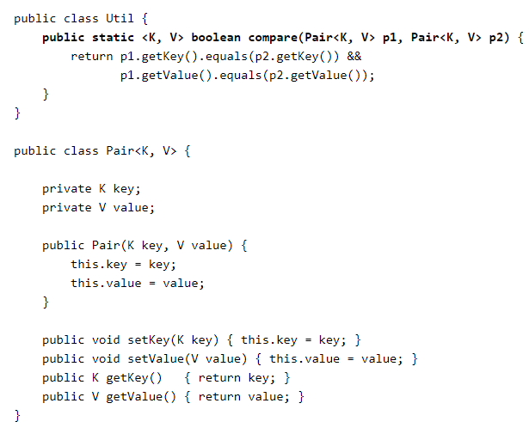
Generics – Methods
Generic methods are methods that introduce their own type parameters.
This is similar to declaring a generic type, but the type parameter's scope is limited to the method where it is declared.
Static and non-static generic methods are allowed, as well as generic class constructors.
The syntax for a generic method includes a list of type parameters, inside angle brackets, which appears before the method's return type.
For static generic methods, the type parameter section must appear before the method's return type.

Slide 34
Generics – Methods – Type Inference
The complete syntax for invoking this method would be:
Pair<Integer, String> p1 = new Pair<>(1, "apple"); Pair<Integer, String> p2 = new Pair<>(2, "pear");
boolean same = Util.<Integer, String>compare(p1, p2);
The type has been explicitly provided, as shown in bold. Generally, this can be left out and the compiler will infer the type that is needed:
Pair<Integer, String> p1 = new Pair<>(1, "apple"); Pair<Integer, String> p2 = new Pair<>(2, "pear");
boolean same = Util.compare(p1, p2);
This feature, known as type inference, allows you to invoke a generic method as an ordinary method, without specifying a type between angle brackets

Slide 35
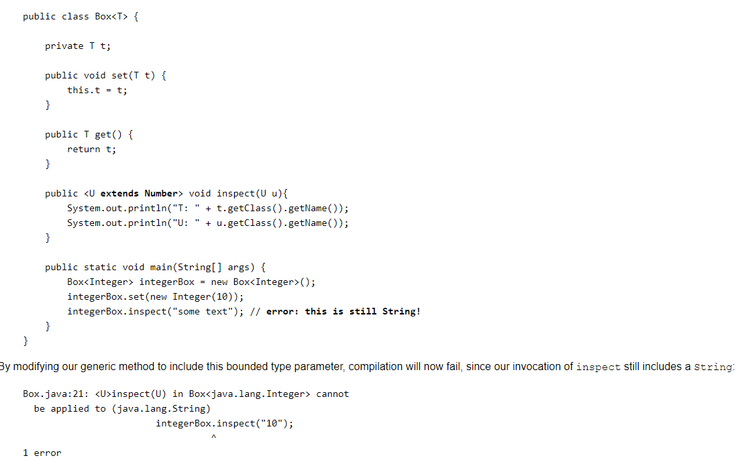
Generics – Bounded Types
There may be times when you want to restrict the types that can be used as type arguments in a parameterized type.
For example, a method that operates on numbers might only want to accept instances of Number or its subclasses.
This is what bounded type parameters are for.
To declare a bounded type parameter, list the type parameter's name, followed by the extends keyword, followed by its upper bound, which in this example is Number.
Note that, in this context, extends is used in a general sense to mean either "extends" (as in classes) or "implements" (as in interfaces).

Slide 36
Generics – Bounded Types
There may be times when you want to restrict the types that can be used as type arguments in a parameterized type.
For example, a method that operates on numbers might only want to accept instances of Number or its subclasses.
This is what bounded type parameters are for.
To declare a bounded type parameter, list the type parameter's name, followed by the extends keyword, followed by its upper bound, which in this example is Number.
Note that, in this context, extends is used in a general sense to mean either "extends" (as in classes) or "implements" (as in interfaces).

Slide 37
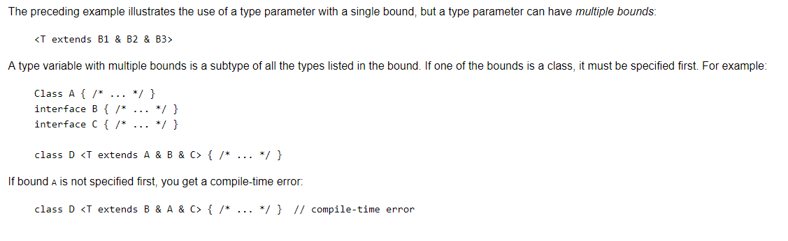
Generics – Multiple Bounded Types

Slide 38
Generics – WildCard
In generic code, the question mark (?), called the wildcard, represents an unknown type.
The wildcard can be used in a variety of situations: as the type of a parameter, field, or local variable; sometimes as a return type (though it is better programming practice to be more specific).
The wildcard is never used as a type argument for a generic method invocation, a generic class instance creation, or a supertype.
You can use an upper bounded wildcard to relax the restrictions on a variable. For example, say you want to write a method that works on List<Integer>, List<Double>, and List<Number>; you can achieve this by using an upper bounded wildcard.

Slide 39
Generics – WildCard
To declare an upper-bounded wildcard, use the wildcard character ('?'), followed by the extends keyword, followed by its upper bound. Note that, in this context, extends is used in a general sense to mean either "extends" (as in classes) or "implements" (as in interfaces).
To write the method that works on lists of Number and the subtypes of Number, such as Integer, Double, and Float, you would specify List<? extends Number>. The term List<Number> is more restrictive than List<? extends Number>because the former matches a list of type Number only, whereas the latter matches a list of type Number or any of its subclasses.

Slide 40
Generics – Type Erasure
Generics were introduced to the Java language to provide tighter type checks at compile time and to support generic programming. To implement generics, the Java compiler applies type erasure to:
  Replace all type parameters in generic types with their bounds or Object if the type parameters are unbounded. The produced bytecode, therefore, contains only ordinary classes, interfaces, and methods.
  Insert type casts if necessary to preserve type safety.
  Generate bridge methods to preserve polymorphism in extended generic types.
Type erasure ensures that no new classes are created for parameterized types; consequently, generics incur no runtime overhead.
During type erasure process, the compiler erases all type parameters and replaces each with its first bound or type parameter, depending on whether it is bounded or unbounded

Slide 41
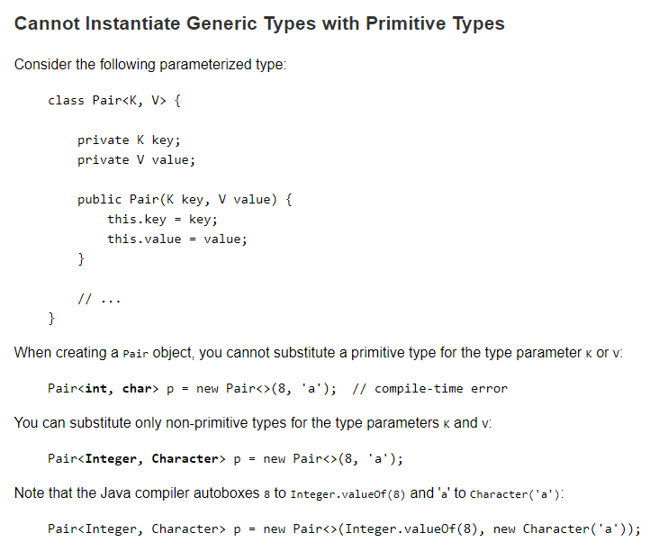
Generics – Restrictions

Slide 42
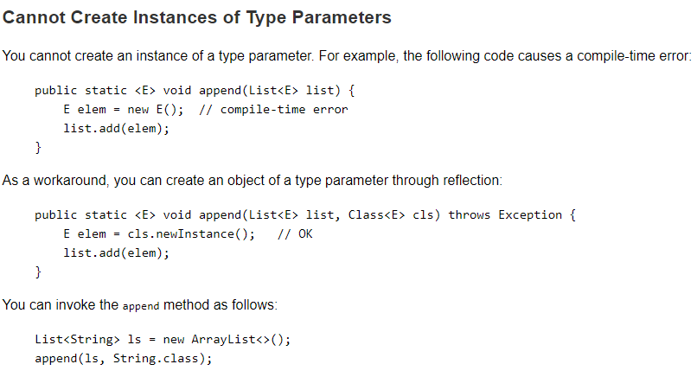
Generics – Restrictions

Slide 43
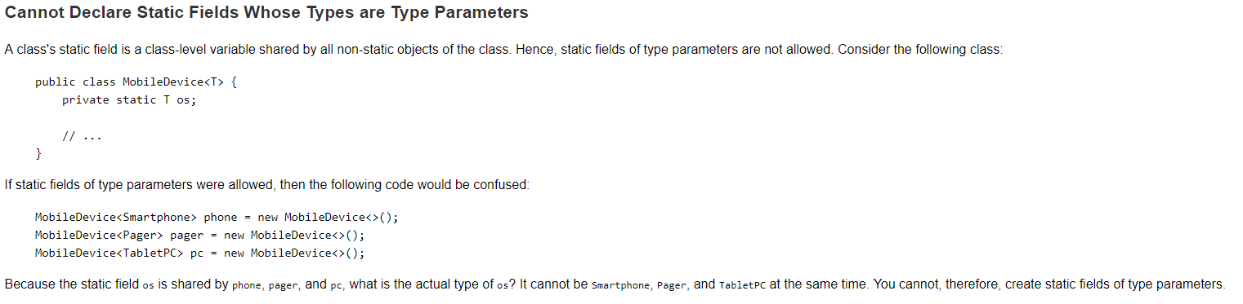
Generics – Restrictions

Slide 44
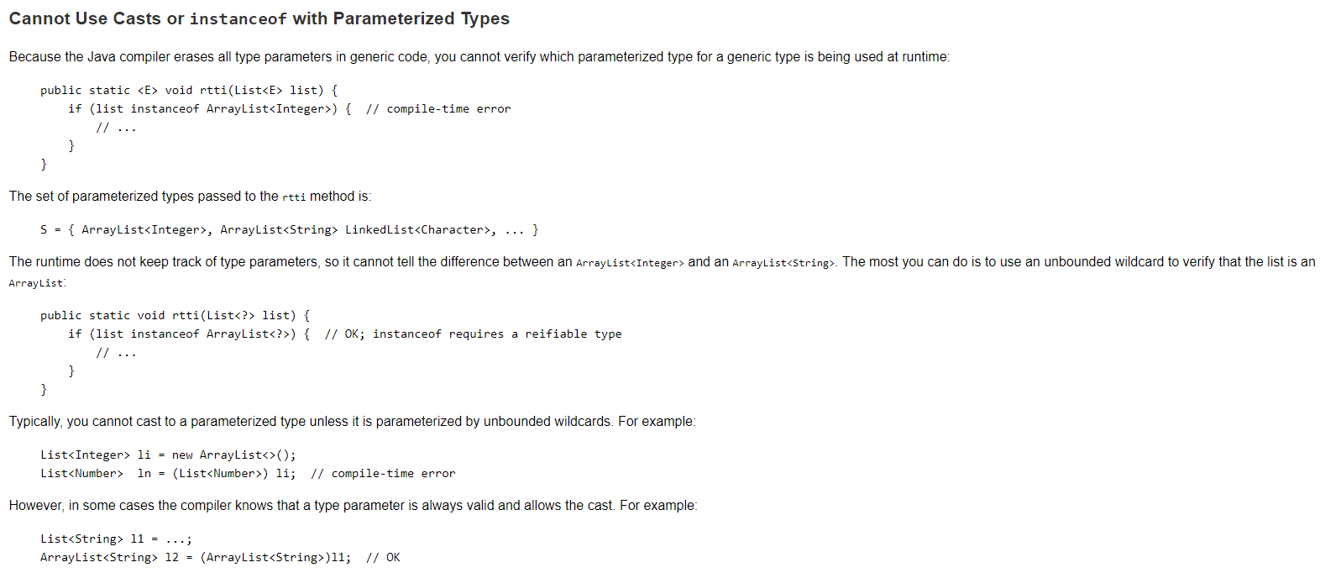
Generics – Restrictions

Slide 45
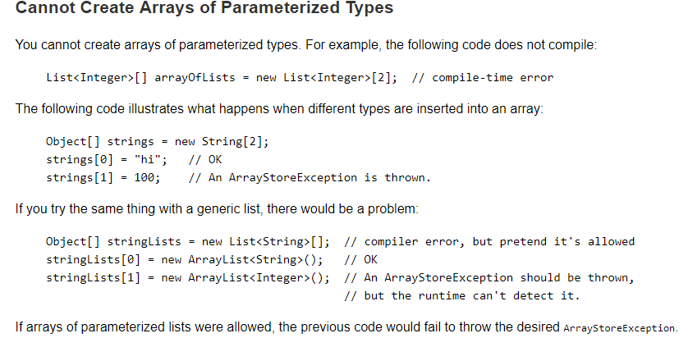
Generics – Restrictions

Slide 46
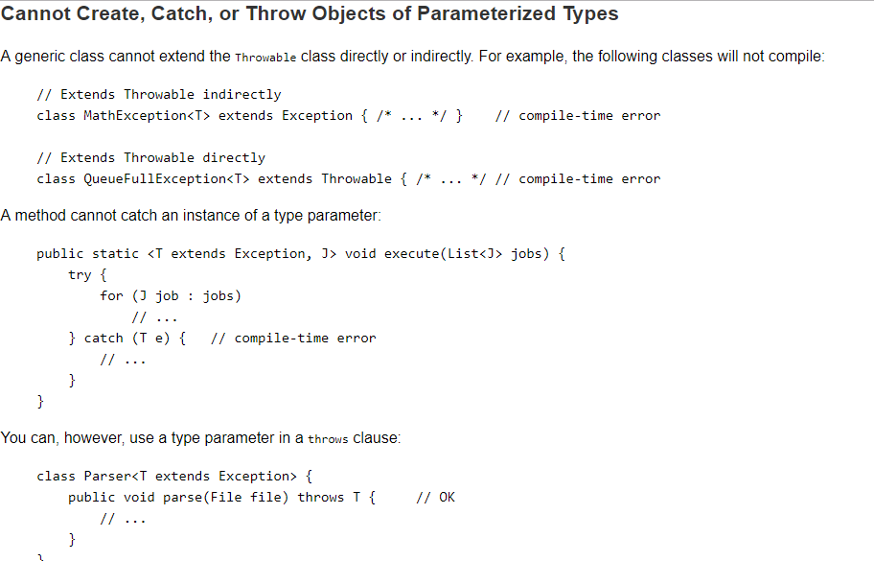
Generics – Restrictions

Slide 47

EXERCISES
Recap

Slide 48
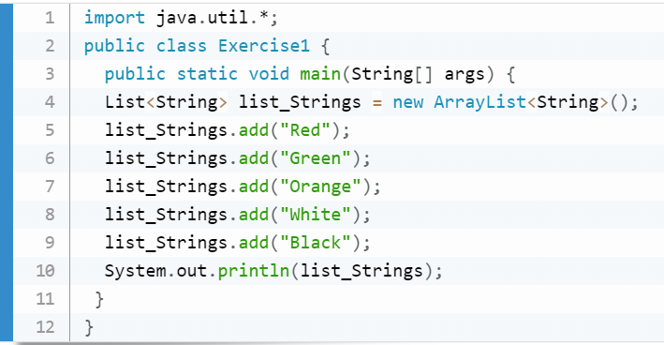
Recap
1. Write a Java program to create a new array list, add some colors (string) and print out the collection

Slide 49
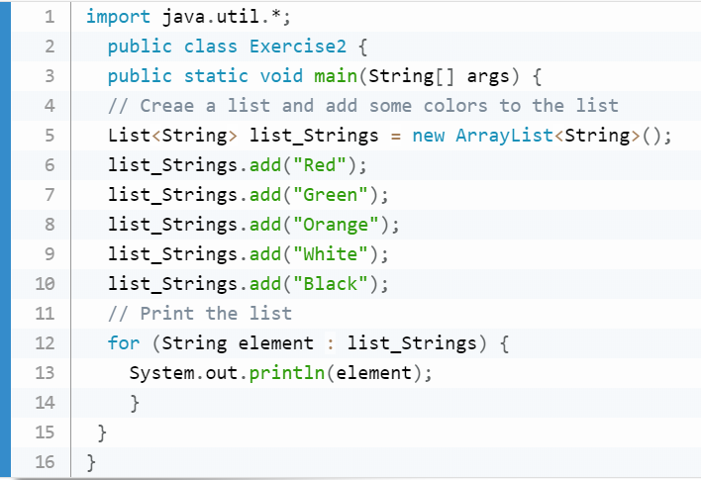
Recap
2. Write a Java program to iterate through all elements in a array list

Slide 50
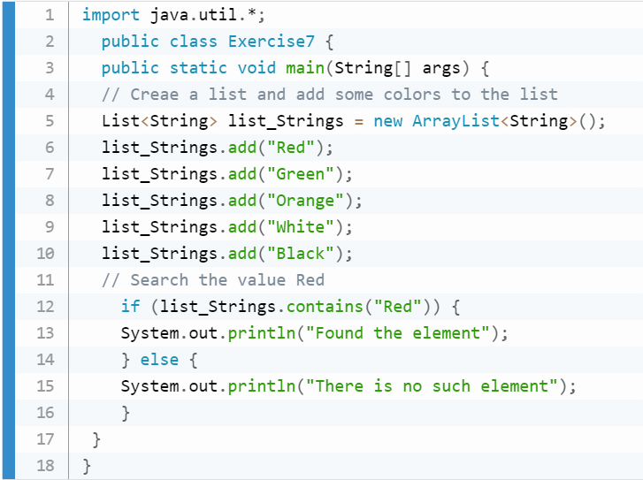
Recap
3. Write a Java program to search an element in a array list.

Slide 51
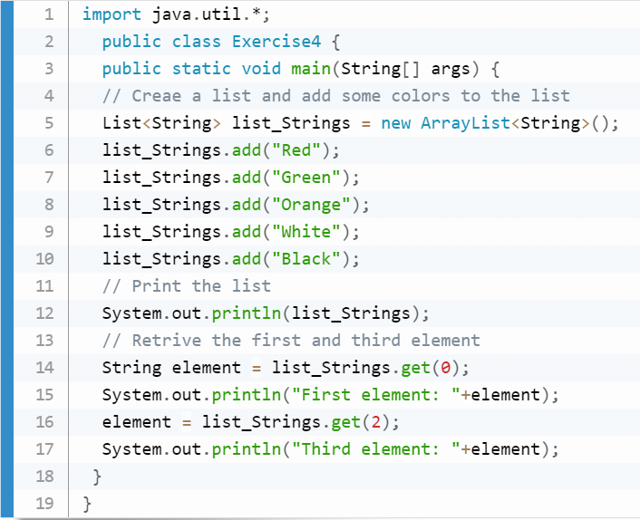
Recap
4. Write a Java program to retrieve an element (at a specified index) from a given array list.

Slide 52
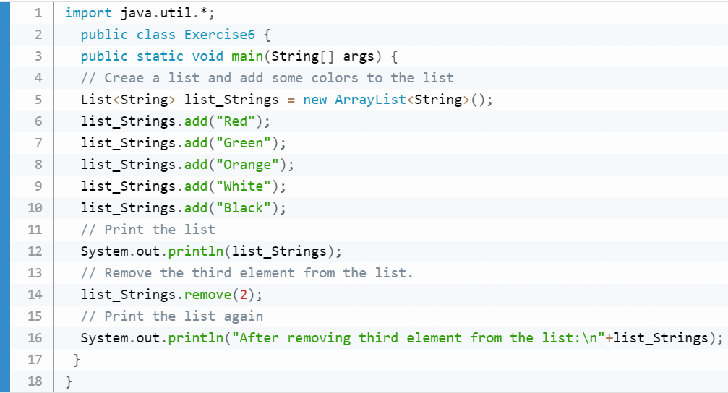
Recap
5. Write a Java program to remove the third element from a array list.

Slide 53
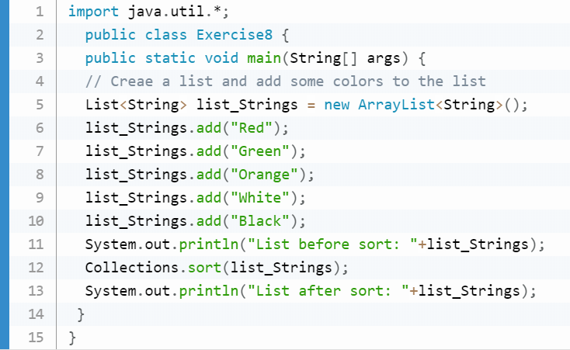
Recap
6. Write a Java program to sort a given array list.

Slide 54
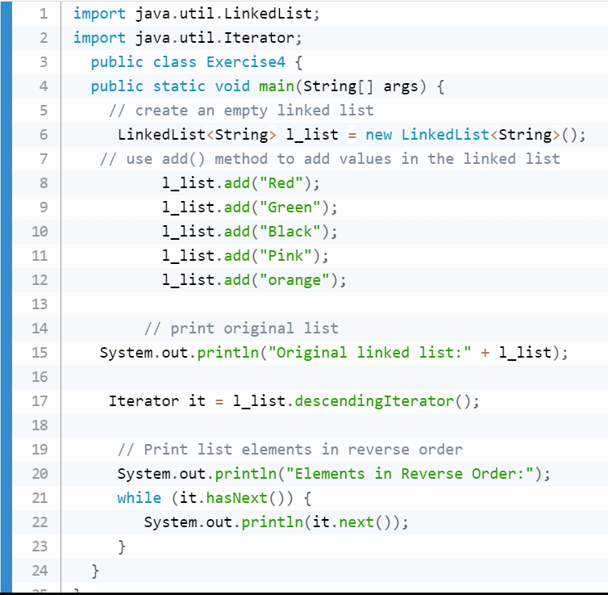
Recap
7. Write a Java program to iterate a linked list in reverse order.

Slide 55
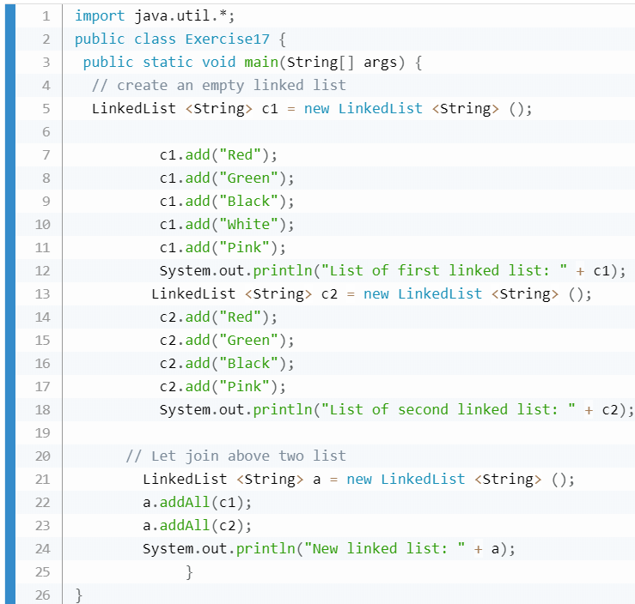
Recap
8. Write a Java program to join two linked lists.

Slide 56
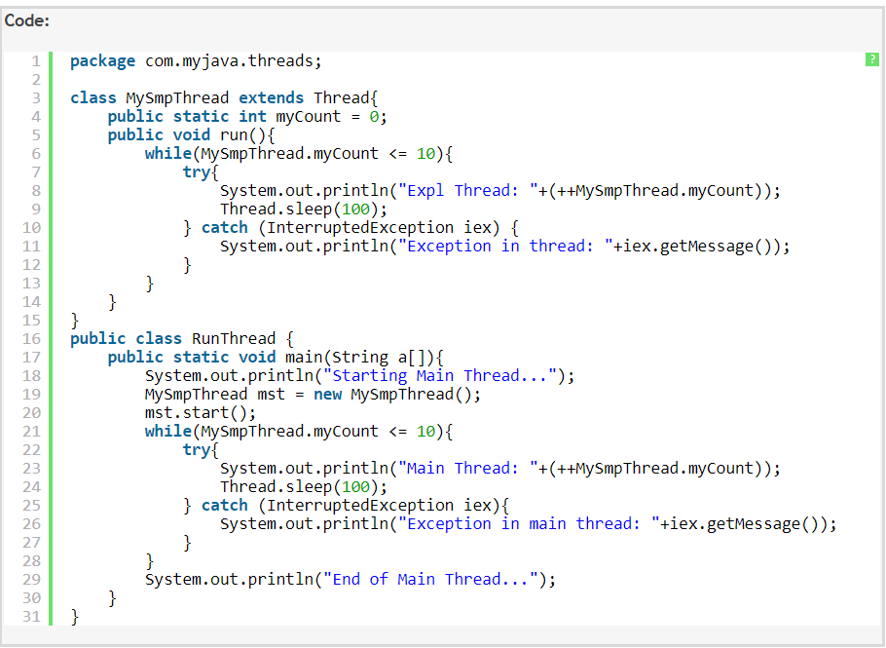
Recap
9. Write a Java thread class and a runclass which invokes the thread class.

Slide 57
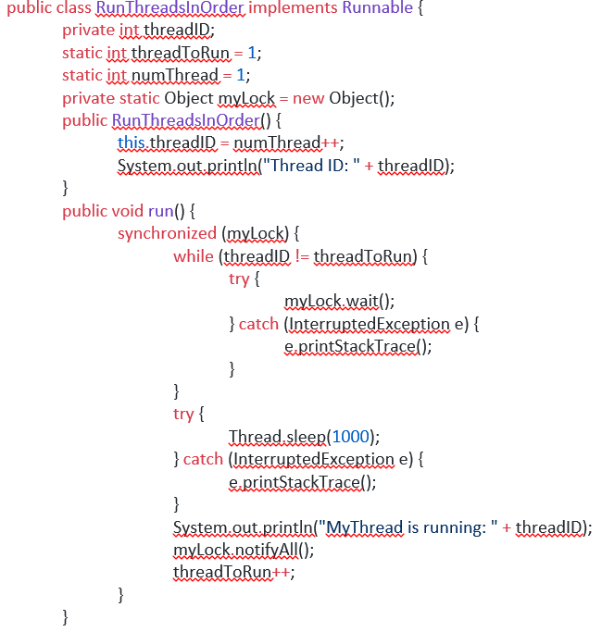
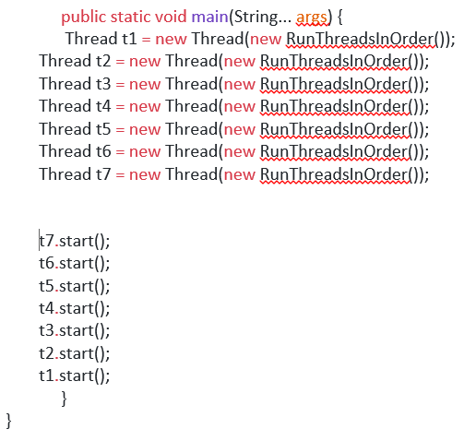
Recap
10. Write a Java thread class to run threads in order.

Slide 58

END OF SESSION.
You can contact me @
avadekkedhil@wilp.bits-pilani.ac.in
7798833492

